Slide 1


The Geographical Distribution of Rudists and Corals
Najat Al Fudhaili
July 27, 2020

Slide 2
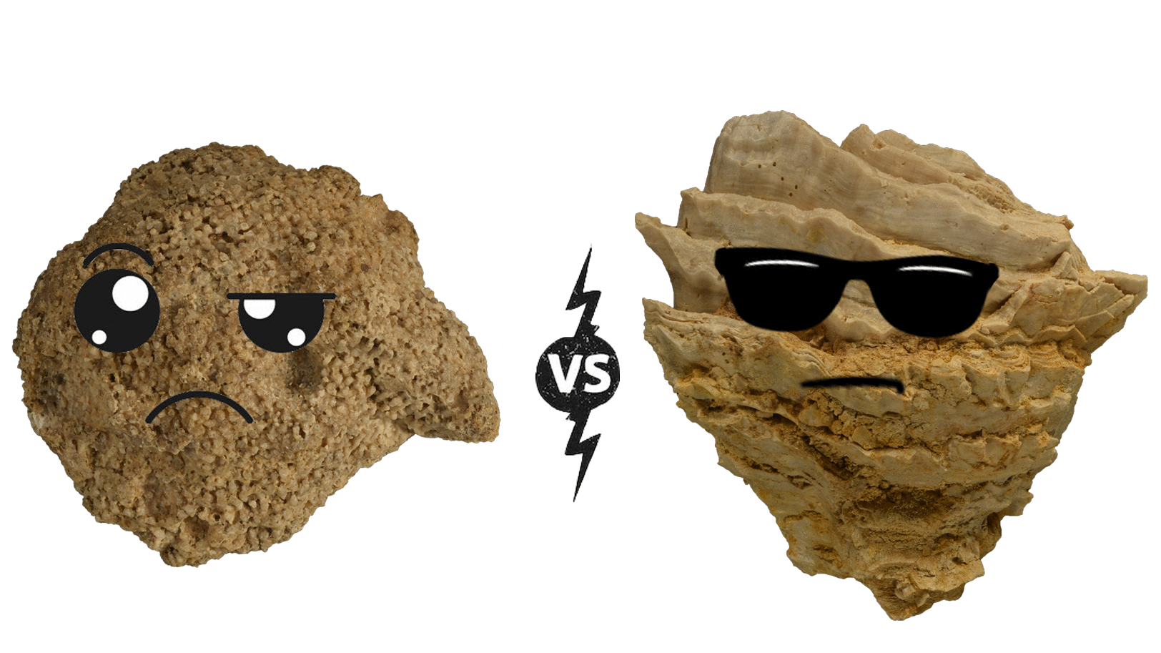
Introduction
Early Cretaceous reefs and biostromes were built predominantly by corals with only a few rudists.
Competition between corals and rudists was a leading factor to changes in the development of the Cretaceous reef.
Rudists diverse into more than 1000 species (Götz, 2003) by the end of the Cretaceous, forming mono to paucispecific assemblages.

Slide 3


Objective
Latest geochemical and sclerochronological study (de Winter, 2020) reveals that rudists are photosymbionts bearing bivalves.
Investigating the diversity dynamic and the latitudinal position of symbiont bearing rudists and zooxanthellate corals throughout the Cretaceous time.

Slide 4

Hypothesis
The high efficiency of photosymbionts rudists promotes their success in expanding within the tropical regions and assessed by their shell morphological features, they impede the growth of zooxanthellate corals communities throughout the Cretaceous time.

Slide 5


Material and methods
Rudists and zooxanthellate corals data from PBDB
divDyn 0.8.0 package
Chronosphere package
Data processing
Sampling assessment
Richness through time
Subsampling:
- Classical Rarefaction
- Shareholder Quorum Subsampling (SQS)
Turnover rates

Slide 6
Results
Number Occurrences

Slide 7
Results
s

Slide 8
Results

Slide 9
Results

Slide 10
Results

Slide 11
Results

Slide 12
Results

Slide 13
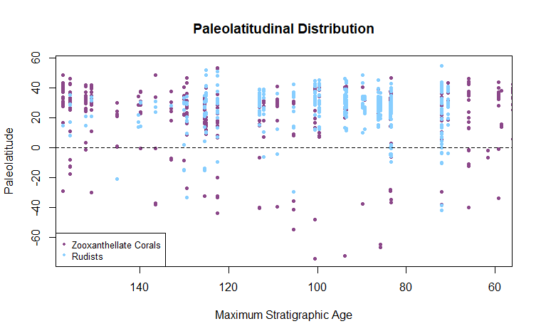
Results

Slide 14
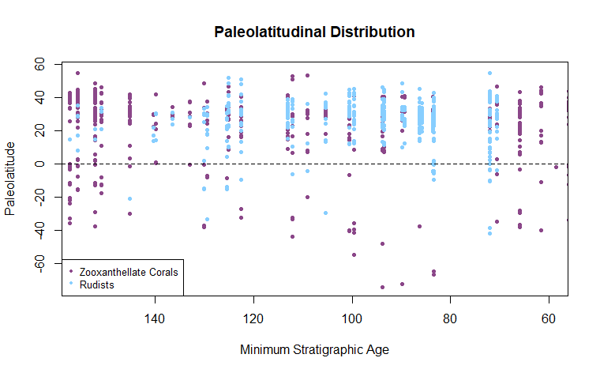
Results

Slide 15
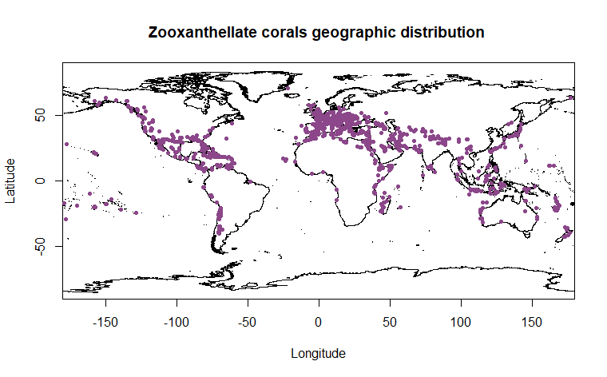
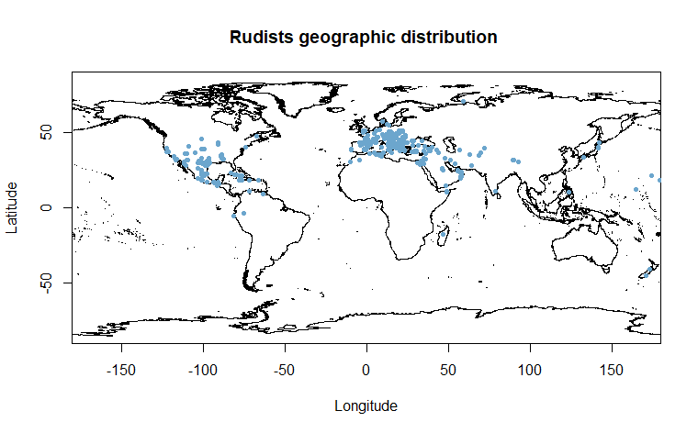
Results

Slide 16
Implication and summary
Rudists occurred during the Late Jurassic and flourished throughout the Cretaceous, becoming more abundant and highly diverse
The palaeolatitudinal distribution of Rudist bivalves shows that they were tropical and reveal higher turnover rates than the zooxanthellate corals.
They both were dominant within the Northern Hemisphere.

Slide 17
References
de Winter, N., Goderis, S., Van Malderen, S., Sinnesael, M., Vansteenberge, S., & Snoeck, C. et al. 2020. Subdaily‐Scale Chemical Variability in a Torreites Sanchezi Rudist Shell: Implications for Rudist Paleobiology and the Cretaceous Day‐Night Cycle. Paleoceanography And Paleoclimatology, 35(2).
Götz, S. (2003). Biotic interaction and synecology in a Late Cretaceous coral–rudist biostrome of southeastern Spain. Palaeogeography, Palaeoclimatology, Palaeoecology, 193(1), 125-138. doi: 10.1016/s0031-0182(02)00719-8
Kauffman, E., & Johnson, C. (1988). The Morphological and Ecological Evolution of Middle and Upper Cretaceous Reef-Building Rudistids. PALAIOS, 3(2), 194. doi: 10.2307/3514530
Kocsis, Á., Reddin, C., Alroy, J., & Kiessling, W. (2019). Therpackage divDyn for quantifying diversity dynamics using fossil sampling data. Methods In Ecology And Evolution, 10(5), 735-743. https://doi.org/10.1111/2041-210x.13161
Raja-Schoob, N. (2020). Basic diversity dynamics of scleractinian corals with divDyn 0.8.0 | evolvED. Retrieved 2020, from https://www.evolv-ed.net/post/divdyn-basic-corals/
Steuber, T. (1996). Stable isotope sclerochronology of rudist bivalves: Growth rates and Late Cretaceous seasonality. Geology 24 (4), 315. doi:10.1130/00917613(1996)024<0315:sisorb>2.3.co;2

Slide 18
Thank you for your attention!

